Slide 1
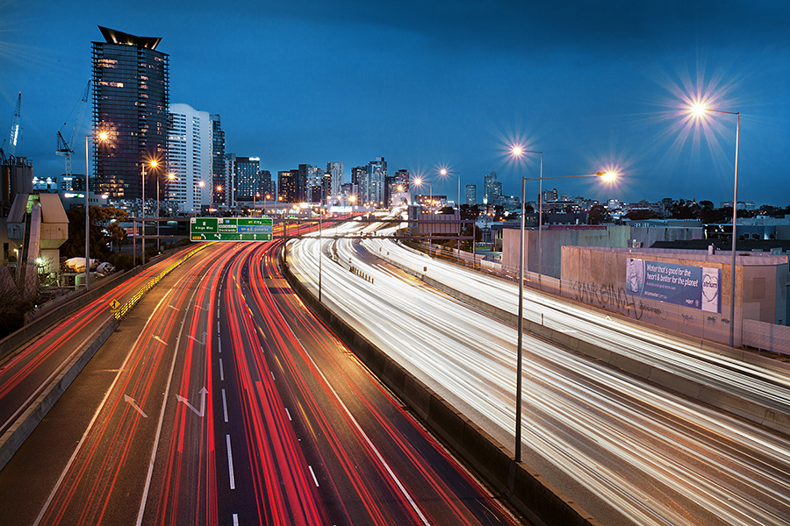
GOZWHIT
A SMART HELMET
FOR INDIAN MARKET

Slide 2
IDEA DESCRIPTION
This project is basically about an implementation of innovative mechanisms to a rider’s helmet to bring out the following advantages –
Internet of Things(IoT) based traffic emergency system
Internet of Things(IoT) based traffic guidance system
Extensive protection from sun strokes
Other useful common utilities
All these facilities are to be implemented on the helmet with maximum cost efficiency to make the final product within the reach of Indian common man.

Slide 3
IoT based Traffic Guidance System
Here the rider will be updated on the oncoming traffic situation through a small helmet mounted screen which will be updated continuously from the traffic cloud based on the rider’s location.
Rider can take the decision on the route depending upon the traffic density.

Slide 4
IoT based Traffic Emergency System
Here the helmet will be mounted with appropriate sensors at appropriate positions on the helmet. They are calibrated to sense high impact due to any accident or crash.
Once they detect the designated input, the rider’s location is immediately sent to a cloud of hospitals where the nearest hospital is notified about that so that ambulance can reach the spot immediately.

Slide 5
Extensive Protection from Sun Strokes
The helmet’s inner lining is coated with a chemical (super absorbent) that, once absorbs cool water, retains the coolness for at least 4 hours, unlike the clothe soaked with cool water which generally riders use around their head while riding.
This prevents dehydration and dizziness and thus prevents accidents.
This also provides a soothing effect to the riders in scorching heat of the summer.

Slide 6
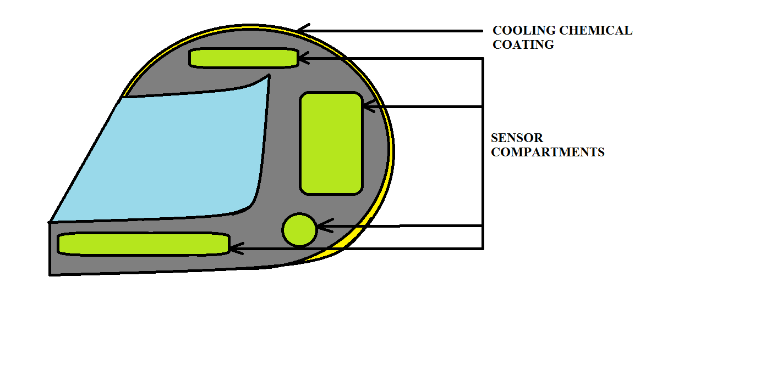
Cross Sectional Diagram

Slide 7
BUSINESS MODEL

Slide 8
Key Partners | Key Activities | Value Propositions | Customer Relationships | Customer Segments
 | Key Resources |  | Channels
R&D(Product improvisation, new products)
Chemical Partners (Polytechnic Industries)
Extensive Protection from Sun strokes
Self-service
Pre and Post sale services
Advertisers and Marketers
Product Manufacturing
IoT based traffic guidance
Personal Assistance
Distribution Partners
Mass Market
IoT based traffic emergency system
Retail Stores
Advertisements
Supply Chain
R&D Unit
Educational Institutions
Sodium Polyacrylate
From Polytechnic Industries
Lowest Cost
Website
Educational Magazines
Cost Structure | Revenue Streams
R&D Costs
Chemical Acquisition Costs
Marketing and Sales
Profit on Sales
Services revenues

Slide 9
Pricing (Total Cost = INR 1300 Only)

Slide 10
PRODUCT RANGES AND
AVAILABLE FACILITIES

Slide 11


FEATURES | GOZWHIT-L | GOZWHIT-XL | GOZWHIT-ZXL
COOLING SYSTEM
TRAFFIC EMERGENCY SYSTEM
INCOMING-CALL RECEIVER
SPEED ALERT SYSTEM
TRAFFIC GUIDANCE SYSTEM

